Slide 1
Cryptography (2022 Fall) CTR security proof, MAC
LiangFeng Zhang
zhanglf@shanghaitech.edu.cn
SIST, ShanghaiTech

Slide 2
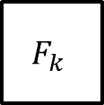

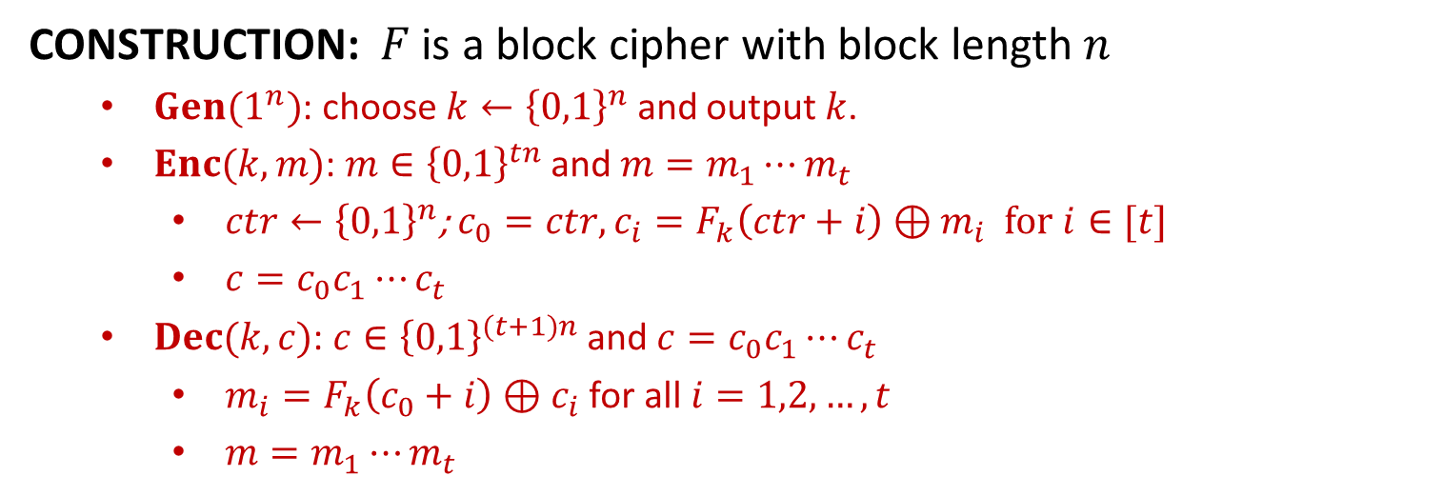



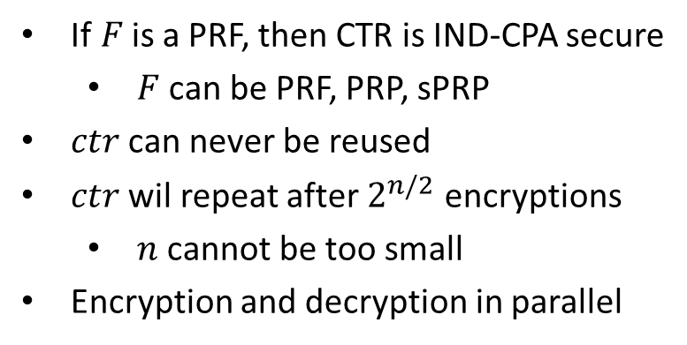











CTR
CONSTRUCTION: $F$ is a block cipher with block length $n$
$Gen(1^{n})$: choose $k←{\left\{0,1\right\}}^{n}$ and output $k$.
$Enc(k,m)$: $m∈{\left\{0,1\right\}}^{tn}$ and $m=m_{1}⋯m_{t}$
$ctr←{\left\{0,1\right\}}^{n}$; $c_{0}=ctr, c_{i}=F_{k}\left(ctr+i\right)⊕m_{i}$ for $i∈[t]$
$c=c_{0}c_{1}⋯c_{t}$
$Dec(k,c)$: $c∈{\left\{0,1\right\}}^{(t+1)n}$ and $c=c_{0}c_{1}⋯c_{t}$
$m_{i}=F_{k}\left(c_{0}+i\right)⊕c_{i}$ for all $i=1,2,…,t$
$m=m_{1}⋯m_{t}$
$$ctr$$
$$ctr+1$$
$$ctr+2$$
$$ctr+3$$
If$F$is a PRF, then CTR is IND-CPA secure
$F$ can be PRF, PRP, sPRP
$ctr$ can never be reused
$ctr$ wil repeat after $2^{n/2}$ encryptions
$n$ cannot be too small
Encryption and decryption in parallel
$$F_{k}$$
$$F_{k}$$
$$F_{k}$$
$$m_{1}$$
$$⨁$$
$$m_{2}$$
$$⨁$$
$$m_{3}$$
$$⨁$$
$$ctr$$
$$c_{1}$$
$$c_{2}$$
$$c_{3}$$

Slide 3
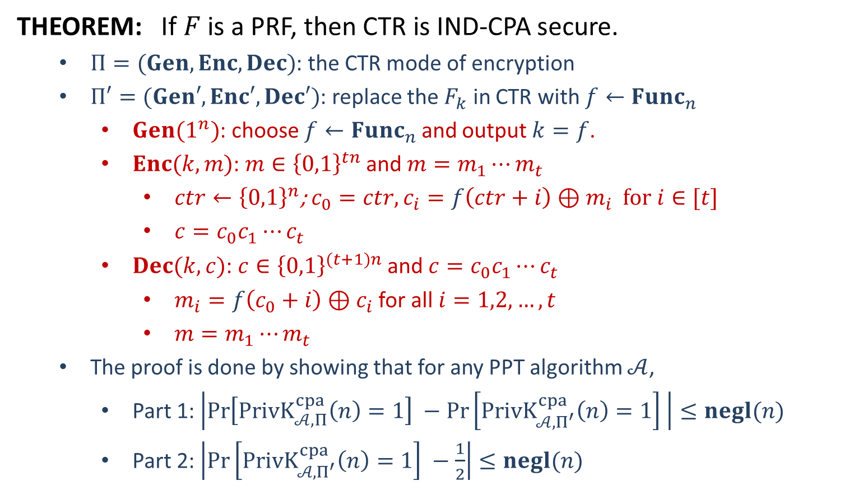
Security
THEOREM: If $F$ is a PRF, then CTR is IND-CPA secure.
$Π=(Gen,Enc,Dec)$: the CTR mode of encryption
$Π′=(Gen′,Enc′,Dec′)$: replace the $F_{k}$ in CTR with $f←Func_{n}$
$Gen(1^{n})$: choose $f←Func_{n}$ and output $k=f$.
$Enc(k,m)$: $m∈{\left\{0,1\right\}}^{tn}$ and $m=m_{1}⋯m_{t}$
$ctr←{\left\{0,1\right\}}^{n}$; $c_{0}=ctr, c_{i}=f\left(ctr+i\right)⊕m_{i}$ for $i∈[t]$
$c=c_{0}c_{1}⋯c_{t}$
$Dec(k,c)$: $c∈{\left\{0,1\right\}}^{(t+1)n}$ and $c=c_{0}c_{1}⋯c_{t}$
$m_{i}=f\left(c_{0}+i\right)⊕c_{i}$ for all $i=1,2,…,t$
$m=m_{1}⋯m_{t}$
The proof is done by showing that for any PPT algorithm $𝒜$,
Part 1: $\left|\operatorname{Pr}\left[PrivK_{𝒜, Π}^{cpa}\left(n\right)=1\right] −\operatorname{Pr}\left[PrivK_{𝒜, Π^{′}}^{cpa}\left(n\right)=1\right] \right|≤negl(n)$
Part 2: $\left|\operatorname{Pr}\left[PrivK_{𝒜, Π^{′}}^{cpa}\left(n\right)=1\right] −\frac{1}{2}\right|≤negl(n)$

Slide 4

























Part 1: $\left|\operatorname{Pr}\left[PrivK_{𝒜, Π}^{cpa}\left(n\right)=1\right] −\operatorname{Pr}\left[PrivK_{𝒜, Π^{′}}^{cpa}\left(n\right)=1\right] \right|≤negl(n)$
$$𝒪$$
$$𝒜$$
$${\left\{{ctr}_{i}+j\right\}}_{j=1}^{t_{i}}$$
$$x_{i}=\{x_{ij}:j∈\left[t_{i}\right]\}$$
$${ctr}_{i}←{\left\{0,1\right\}}^{n}$$
$$ctr_{i}$$
$$\{𝒪\left({ctr}_{i}+j\right)\}$$
$$\{𝒪\left({ctr}_{i}+j\right)⊕x_{ij}\}$$
$$m_{0},m_{1}$$
$${\left\{ctr+j\right\}}_{j=1}^{t}$$
$$ctr←{\left\{0,1\right\}}^{n}$$
$$\left|m_{0}\right|=|m_{1}|$$
$${\left\{𝒪\left(ctr+j\right)\right\}}_{j=1}^{t}$$
$$b←\{0,1\}$$
$$ctr$$
$$\{𝒪\left(ctr+j\right)⊕m_{bj}\}$$
$${\left\{{ctr}_{i}+j\right\}}_{j=1}^{t_{i}}$$
$$x_{i}$$
$${ctr}_{i}←{\left\{0,1\right\}}^{n}$$
$$ctr_{i}$$
$$\{𝒪\left({ctr}_{i}+j\right)\}$$
$$\{𝒪\left({ctr}_{i}+j\right)⊕x_{ij}\}$$
$$b^{′′}=\left\{\begin{aligned}0 b^{′}≠b \\ 1 b^{′}=b\end{aligned}\right.$$
$$b′$$
$$𝒟$$
$\left|\operatorname{Pr}\left[PrivK_{𝒜, Π}^{cpa}\left(n\right)=1\right] −\operatorname{Pr}\left[PrivK_{𝒜, Π^{′}}^{cpa}\left(n\right)=1\right] \right|=\left|\operatorname{Pr}\left[𝒟^{F_{k}}=1\right]−\operatorname{Pr}\left[𝒟^{f}=1\right]\right|$

Slide 5








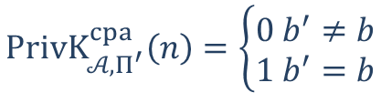











Part 2: $\left|\operatorname{Pr}\left[PrivK_{𝒜, Π^{′}}^{cpa}\left(n\right)=1\right] −\frac{1}{2}\right|≤negl(n)$
$$f←Func_{n}$$
$$𝒜$$
$$x_{i}=\{x_{ij}:j∈\left[t_{i}\right]\}$$
$${ctr}_{i}←{\left\{0,1\right\}}^{n}$$
$$ctr_{i}$$
$$\{f\left({ctr}_{i}+j\right)⊕x_{ij}\}$$
$$m_{0},m_{1}$$
$$ctr←{\left\{0,1\right\}}^{n}$$
$$\left|m_{0}\right|=|m_{1}|$$
$$b←\{0,1\}$$
$$challenger$$
$$ctr$$
$$\{f\left(ctr+j\right)⊕m_{bj}\}$$
$$x_{i}=\{x_{ij}:j∈\left[t_{i}\right]\}$$
$${ctr}_{i}←{\left\{0,1\right\}}^{n}$$
$$ctr_{i}$$
$$\{f\left({ctr}_{i}+j\right)⊕x_{ij}\}$$
$$PrivK_{𝒜, Π^{′}}^{cpa}\left(n\right)=\left\{\begin{aligned}0 b^{′}≠b \\ 1 b^{′}=b\end{aligned}\right.$$
$$b′$$
$q\left(n\right):$ upper bound of the message length&number of queries

Slide 6
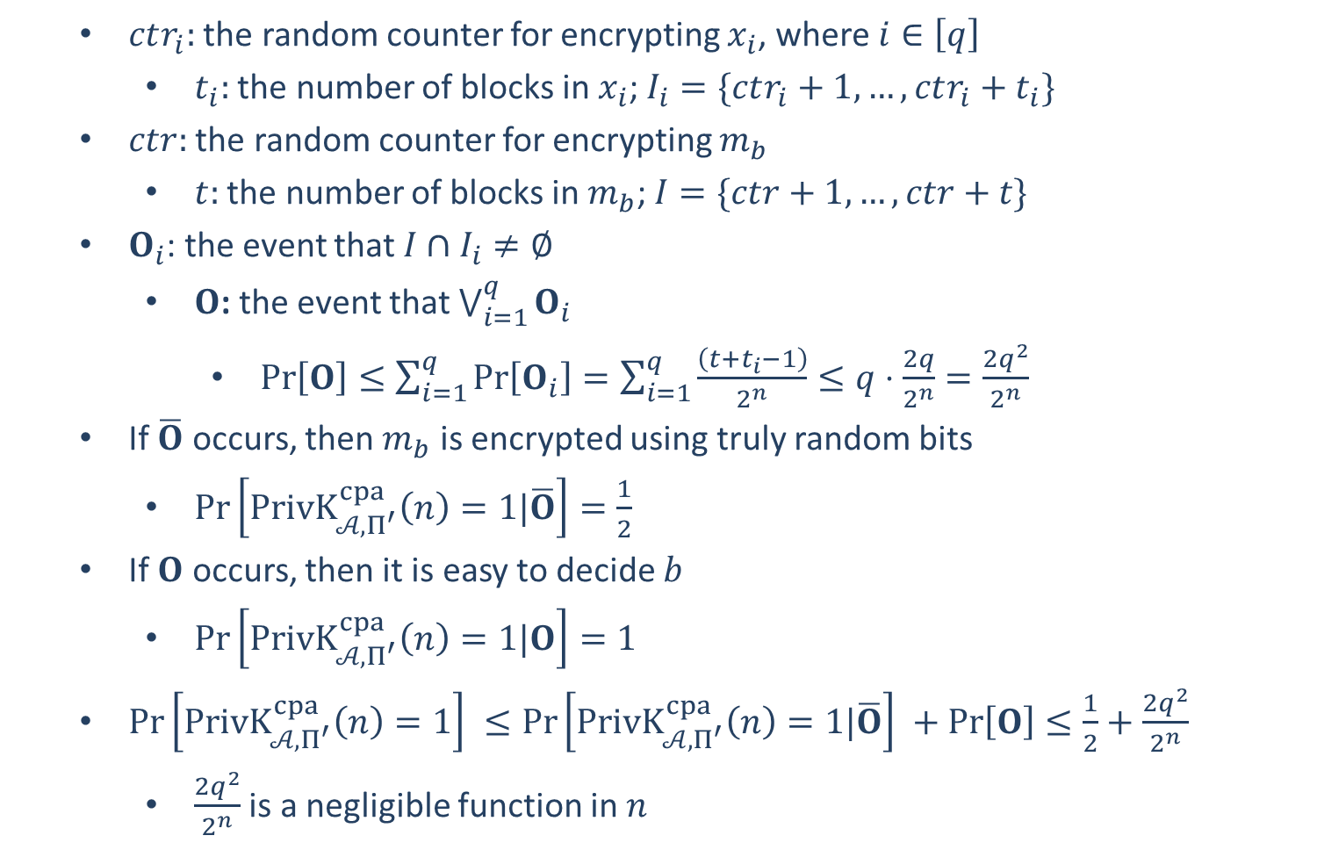
$ctr_{i}:$ the random counter for encrypting $x_{i}$, where $i∈\left[q\right]$
$t_{i}:$ the number of blocks in $x_{i}$; $I_{i}=\{ctr_{i}+1,…,ctr_{i}+t_{i}\}$
$ctr:$ the random counter for encrypting $m_{b}$
$t:$ the number of blocks in $m_{b}$; $I=\{ctr+1,…,ctr+t\}$
$O_{i}$: the event that $I∩I_{i}≠∅$
$O$: the event that $\bigvee_{i=1}^{q}{O_{i}}$
$\operatorname{Pr}\left[O\right]≤\sum_{i=1}^{q}{\operatorname{Pr}\left[O_{i}\right]}=\sum_{i=1}^{q}{\frac{\left(t+t_{i}−1\right)}{2^{n}}}≤q⋅\frac{2q}{2^{n}}=\frac{2q^{2}}{2^{n}}$
If $\overline{O}$ occurs, then $m_{b}$ is encrypted using truly random bits
$\operatorname{Pr}\left[PrivK_{𝒜, Π^{′}}^{cpa}\left(n\right)=1|\overline{O}\right]=\frac{1}{2}$
If $O$ occurs, then it is easy to decide $b$
$\operatorname{Pr}\left[PrivK_{𝒜, Π^{′}}^{cpa}\left(n\right)=1|O\right]=1$
$\operatorname{Pr}\left[PrivK_{𝒜, Π^{′}}^{cpa}\left(n\right)=1\right] ≤\operatorname{Pr}\left[PrivK_{𝒜, Π^{′}}^{cpa}\left(n\right)=1|\overline{O}\right] +\operatorname{Pr}\left[O\right]≤\frac{1}{2}+\frac{2q^{2}}{2^{n}}$
$\frac{2q^{2}}{2^{n}}$ is a negligible function in $n$

Slide 8


Message Integrity
Transfer $1000 from Alice’s account to Bob’s
$$Alice$$
Questions that will be asked by the bank:
Is the message really from Alice?
Has the message been modified?
Message Integrity: prevent undetected tampering of messages
Unauthorized modifications should be detectable
Encryptions cannot provide message integrity:
Encryption can prevent unauthorized access of the messages
Encryption cannot prevent undetected tampering of messages

Slide 9
Encryption $⇏$ Integrity
One-Time Pad: $Enc\left(k,m\right)=k⊕m$
Attack: flip a bit of $Enc\left(k,m\right)$
the same bit (location) of $m$ will be flipped, without being detected
PRG-based Encryption Scheme: $Enc\left(k,m\right)=G\left(k\right)⊕m$ ($G$ is a PRG)
Attack: flip a bit of $Enc\left(k,m\right)$
the same bit (location) of $m$ will be flipped, without being detected
PRF-based Encryption Scheme: $Enc\left(k,m\right)=\left(r,F_{k}\left(r\right)⊕m\right)=(c_{1},c_{2})$
Attack: flip a bit of $c_{2}$
the same bit (location) of $m$ will be flipped, without being detected

Slide 10
Encryption $⇏$ Integrity
OFB: $F$ is a length-preserving PRF/PRP/sPRP
$$IV$$
$$F_{k}$$
$$F_{k}$$
$$F_{k}$$
$$m_{1}$$
$$⨁$$
$$m_{2}$$
$$⨁$$
$$m_{3}$$
$$⨁$$
$$IV$$
$$c_{1}$$
$$c_{2}$$
$$c_{3}$$
Attack: flip a bit of any of ciphertext blocks $c_{1},c_{2},c_{3}$
the same bit (location) of the message will be flipped, without being detected

Slide 11
Encryption $⇏$ Integrity
CTR: $F$ is a length-preserving PRF/PRP/sPRP
$$ctr$$
$$ctr+1$$
$$ctr+2$$
$$ctr+3$$
$$F_{k}$$
$$F_{k}$$
$$F_{k}$$
$$m_{1}$$
$$⨁$$
$$m_{2}$$
$$⨁$$
$$m_{3}$$
$$⨁$$
$$ctr$$
$$c_{1}$$
$$c_{2}$$
$$c_{3}$$
Attack: flip a bit of any of ciphertext blocks $c_{1},c_{2},c_{3}$
the same bit (location) of the message will be flipped, without being detected

Slide 12
Encryption $⇏$ Integrity
CBC: $F$ is a length-preserving PRP/sPRP
$$m_{1}$$
$$m_{2}$$
$$m_{3}$$
$$IV$$
$$⨁$$
$$⨁$$
$$⨁$$
$$F_{k}$$
$$F_{k}$$
$$F_{k}$$
$$IV$$
$$c_{1}$$
$$c_{2}$$
$$c_{3}$$
Attack: flip a bit of the initial vector $IV$
The same bit (location) of $m_{1}$ will be flipped, without being detected

Slide 13
Encryption $⇏$ Integrity
ECB: $F$ is a length-preserving PRP/sPRP
$$m_{1}$$
$$m_{2}$$
$$m_{3}$$
$$F_{k}$$
$$F_{k}$$
$$F_{k}$$
$$c_{1}$$
$$c_{2}$$
$$c_{3}$$
Attacks: Change the order of ciphertext blocks: $c_{1}c_{2}c_{3}→c_{3}c_{2}c_{1}$
decryption: $c_{3}c_{2}c_{1}→m_{3}m_{2}m_{1}$
The message blocks will be reordered, without being detected

Slide 15

Message Authentication Code
Objective: ensures message integrity in the following sense
Detect unauthorized modification of a message
Detect unauthorized injection of a message
DEFINITION: A message authentication code (MAC) is a tuple
$(Gen, Mac,Vrfy)$ of three PPT algorithms, where
$k←Gen\left(1^{n}\right)$: key-generation, $\left|k\right|≥n$
$t←Mac(k,m)$: tag-generation, $m∈{\left\{0,1\right\}}^{∗}$
$\left\{0,1\right\}←Vrfy(k,m,t)$: verification
Correctness: $Vrfy\left(k,m,Mac\left(k,m\right)\right)=1$
message $m$
tag $t$
$$k$$
$$k$$

